Slide 1

VODAFONE
TechLink Solutions
Multi-Branch Network Design & Python Automation
HQ Cairo
Branch 1 Alex
Branch 2 Giza
Omar Magdy Shawky
Ahmed Mohamed-Roushdy, Vodafone | June 25, 2026
Cisco Packet Tracer
Notes:
Introduce the project: TechLink Solutions, 3-site Egyptian branch network. Designed in Cisco Packet Tracer and automated with Python.

Slide 2
Project Overview
TechLink Solutions | Multi-Branch Egyptian Network
3
6
6
100%
Branch
Sites
WAN Links
(4P + 4B)
VLANs
(2 per site)
Connectivity
Verified
Objective
Tools & Technologies
Design a multi-branch company network for TechLink Solutions
Implement dual WAN redundancy (Primary + Backup) per branch
Segment traffic with VLAN 10 (Management) and VLAN 20 (Users)
Automate failure detection and rerouting with Python
Verify full inter-site connectivity in Cisco Packet Tracer
Cisco Packet Tracer
Network simulation & testing
Python 3
Automation scripting engine
JSON
Link-state configuration store
Static Routing
With floating backup routes (AD=10)
Multilayer Switches
Inter-VLAN routing (L3 SVIs)
Notes:
3 sites, 6 WAN links (4 primary + 4 backup = actually 4 links total per design), 6 VLANs, full connectivity verified in PT.

Slide 3
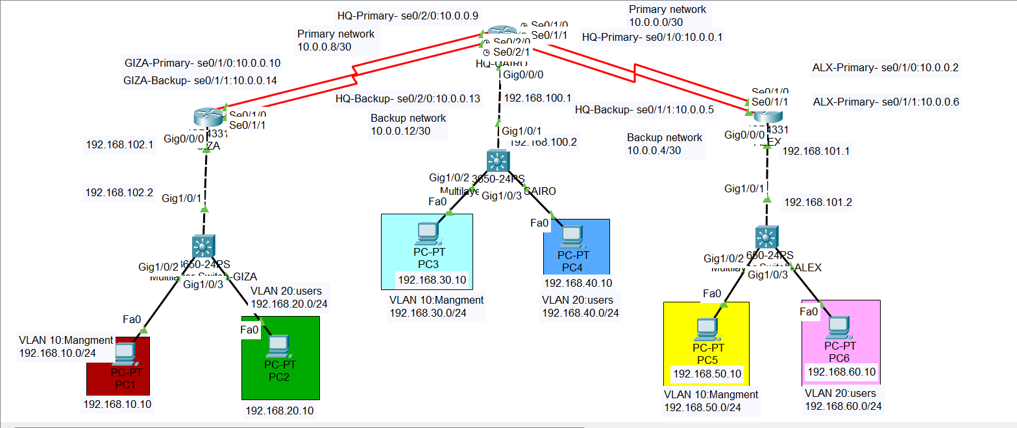
Network Topology
Hub-and-Spoke | 3 Sites | Dual WAN Redundancy per Branch
HQ
HQ-CAIRO
Hub router
Serial 0/2/0 & 0/2/1
10.0.0.1 / .5 / .9 / .13
B1
ALEX Branch
Spoke 1
Serial 0/1/0 & 0/1/1
10.0.0.2 / 10.0.0.6
B2
GIZA Branch
Spoke 2
Serial 0/1/0 & 0/1/1
10.0.0.10 / 10.0.0.14
SW
MLS Switches
3650-24PS per site
VLAN 10 + VLAN 20
L3 inter-VLAN routing
Notes:
Hub-and-Spoke with HQ Cairo as central aggregation point. Red serial lines = WAN. Black dashed = GE uplinks to MLS. Redundant serial links for each branch.

Slide 4
IP Addressing Plan
WAN Serial /30 Links + LAN /24 VLANs | RFC 1918 Private Space
WAN Links (Serial /30)
VLAN Networks (/24)
Link | Network | HQ IP | Branch IP
HQ↔ALEX Primary | 10.0.0.0/30 | 10.0.0.1 | 10.0.0.2
HQ↔ALEX Backup | 10.0.0.4/30 | 10.0.0.5 | 10.0.0.6
HQ↔GIZA Primary | 10.0.0.8/30 | 10.0.0.9 | 10.0.0.10
HQ↔GIZA Backup | 10.0.0.12/30 | 10.0.0.13 | 10.0.0.14
Site | VLAN | Name | Network
Cairo | 10 | Management | 192.168.30.0/24
Cairo | 20 | Users | 192.168.40.0/24
Alex | 10 | Management | 192.168.50.0/24
Alex | 20 | Users | 192.168.60.0/24
Giza | 10 | Management | 192.168.10.0/24
Giza | 20 | Users | 192.168.20.0/24
Key Device Interfaces
Site | Device | Interface | IP Address | Mask
Cairo HQ | HQ-CAIRO Router | Gi0/0/0 | 192.168.100.1 | 255.255.255.252
Cairo HQ | MLS-CAIRO | VLAN 10 SVI | 192.168.30.1 | 255.255.255.0
Alex | ALEX Router | Gi0/0/0 | 192.168.101.1 | 255.255.255.252
Giza | GIZA Router | Gi0/0/0 | 192.168.102.1 | 255.255.255.252
Notes:
WAN /30 networks conserve address space — only 2 usable IPs needed per point-to-point link. Each site has its own /24 block per VLAN for easy route summarisation.

Slide 5
Routing Strategy
Static Routing + Floating Backup Routes | AD = 10 for Backup
Why Static Routing?
Floating Route Logic
Admin Distance (AD)
Fixed 3-site topology – no dynamic changes
Zero CPU overhead vs OSPF/EIGRP
Simple to audit and troubleshoot
Full admin control of paths
Backup via floating AD=10 routes
Primary route
ip route X.X.X.0 ... 10.0.0.X
Backup route (AD = 10)
ip route X.X.X.0 ... 10.0.0.X 10
Backup installs ONLY when
primary is removed from table.
Lower number wins → AD 1 primary
AD 10 backup (higher = less preferred).
Connected
0
Static
1
This backup
10
OSPF
110
RIP
120
Route Configuration Summary
Router | Destination | Next Hop | Type
HQ-CAIRO | 192.168.10.0/24 | 10.0.0.10 | Primary
HQ-CAIRO | 192.168.10.0/24 | 10.0.0.14 AD=10 | Backup
HQ-CAIRO | 192.168.50.0/24 | 10.0.0.2 | Primary
HQ-CAIRO | 192.168.50.0/24 | 10.0.0.6 AD=10 | Backup
ALEX | All non-local | 10.0.0.1 / 10.0.0.5 AD=10 | Primary/Backup
GIZA | All non-local | 10.0.0.9 / 10.0.0.13 AD=10 | Primary/Backup
Notes:
Backup routes have AD=10 — higher than static default of 1, so they lose to the primary but win if primary is gone. This creates automatic failover without any dynamic routing protocol.

Slide 6
Python Automation Engine
network_automation.py + network_status.json | Automatic Failover Logic
network_automation.py
1
Read JSON
import json, time
from datetime import datetime
with open("network_status.json") as f:
network = json.load(f)
for site, data in network.items():
primary = data["primary_link"]
backup = data["backup_link"]
if primary == "UP":
route = "PRIMARY"
else:
if backup == "UP":
write_log("Activating Backup...")
route = "BACKUP"
else:
route = "DOWN"
Load network_status.json
Get primary & backup state
per site (UP / DOWN)
2
Evaluate Links
Primary UP → route PRIMARY
Primary DOWN + Backup UP
→ Activate backup route
3
Apply & Log
Push ip route commands
Write timestamped log
Print FINAL SUMMARY
Notes:
The script is intentionally simple — no netmiko or SSH needed because Packet Tracer doesn't support SSH automation. Python reads JSON state and outputs the logic. In production, you'd connect this to a real device via netmiko.

Slide 7
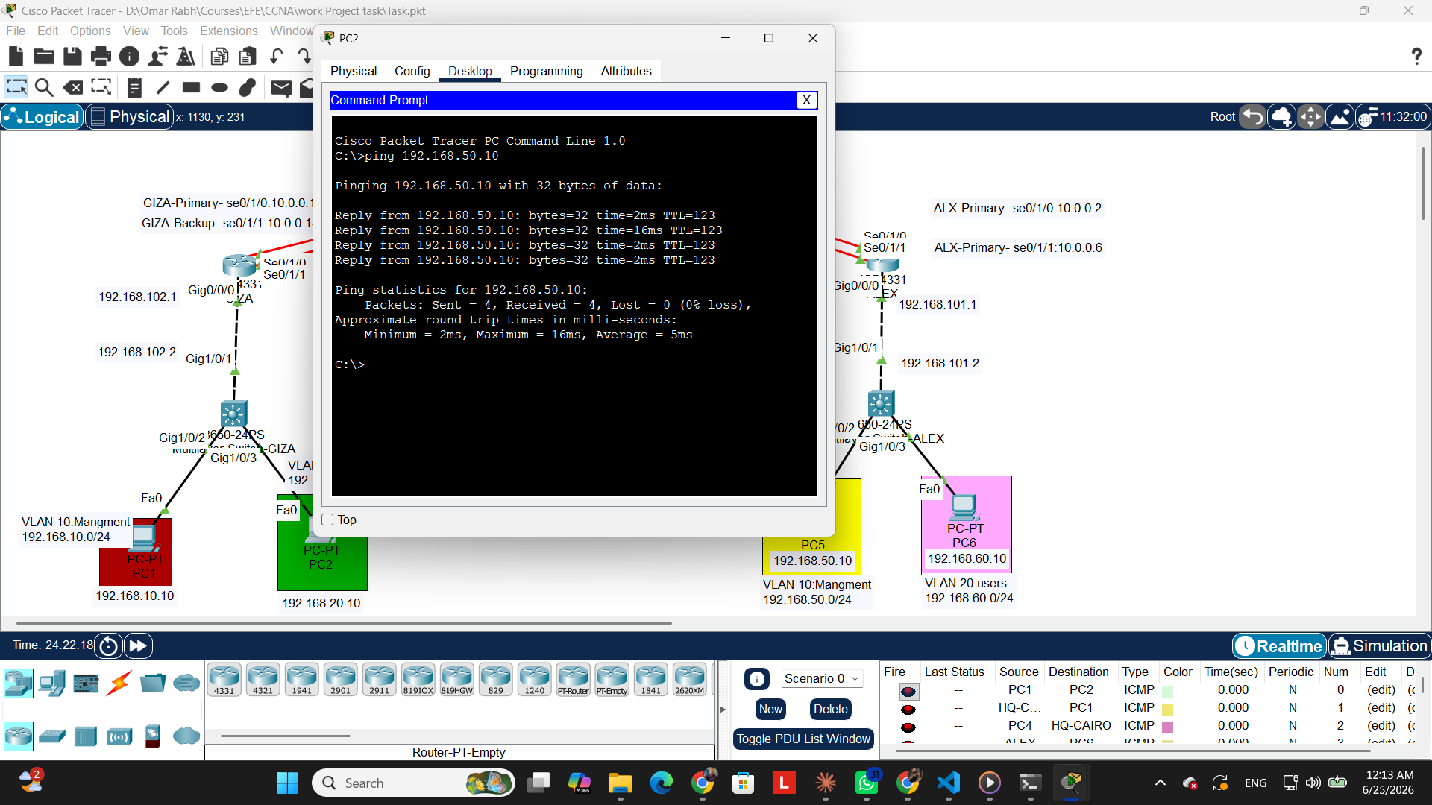
Results & Connectivity Proof
Live Packet Tracer Test | 4/4 Packets | 0% Loss
4 / 4
✓
PASS
Packets Sent / Received
0%
✓
PASS
Packet Loss
5ms
✓
PASS
Average RTT
3 / 3
Omar Magdy Shawky Ahmed Mohamed-Roushdy, Vodafone | June 25, 2026
✓
PASS
PC2 (Giza 192.168.20.10) → PC5 (Alexandria 192.168.50.10)
Sites Reachable
Notes:
Cross-site ping from PC2 (Giza) to PC5 (Alexandria). Traffic travels: PC2 → MLS-GIZA → GIZA router → HQ-CAIRO → ALEX router → MLS-ALEX → PC5. 4 packets, 0 loss, proves full routing works.

